Slide 1

Fall Detection System Using Sensors Embedded In Smartphones
By,
Jathin Sreenivas,
Vineeth Bhat,
Vidya Gopalakrishnarao

Slide 2
Project Vision
Smartphones are embedded with sensors using which we can extract data to perform various human activity recognition. This projects uses that idea to detect a fall and propose a fall detection system using sensors embedded in smartphones.

Slide 3
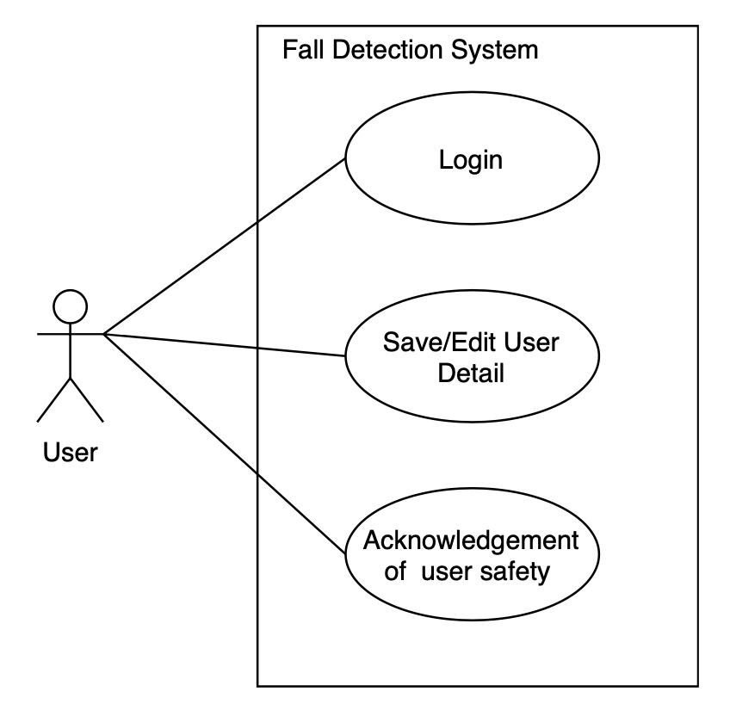
Use Case

Slide 4
Sequence Diagram

Slide 5
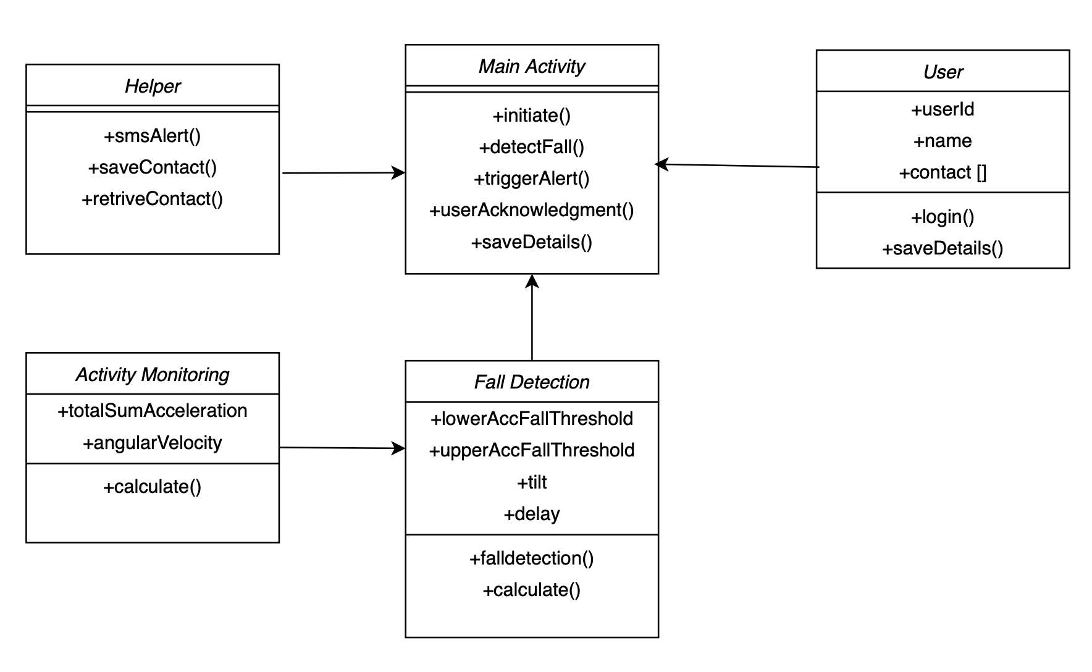
Class Diagram

Slide 6
Flowchart

Slide 7
Development environment
Development Environment: Android
Hardware sensors are accessed using the dedicated android hardware package (android.hardware). It includes the following classes and interfaces.
SensorManager
Sensor
SensorEvent
SensorEventListner
Hardware and Software
Smartphone: Google Pixel
Operating System: Android
IDE: Android Studio
Version Control: GitHub
Sensors Used
Accelerometer
Gyroscope

Slide 8
Project Demonstration
Targeted group of people[1]:
Based on the literature we are referring, which considered 6 individuals of below mentioned age, weight and height group fall detection algorithm is defined.
Age group : 30 – 39 years
Weight group: 59 kgs – 72 kgs
Height: 1.68m – 1.76m
Types of falls : Forward, backward

Slide 9
Testing
Sum vector(FT1) = 2.1g
Angular Velocity(FT2) = 3.1 rad/s
Tilt (FT3) = 60 degrees
Total cases of actual fall = 24 subjects * 2 types of fall
Total cases of non-fall (daily activities) = 9 subjects * 9 cases
 |  | Predicted
 |  | Fall | Non-Fall
Actual | Fall | 37 (True Positive) | 11 (False Negative)
 | Non-Fall | 18 (False Positive) | 63 (True Negative)
Result: Sensitivity = 0.7708
Specificity = 0.7777

Slide 10
References
Sensors: https://developer.android.com/guide/topics/sensors Accessed: 09.06.2020
Gyroscope:https://ef.engr.utk.edu/hyperphysics/hbase/gyr.html Accessed: 09.06.2020
Live Science: https://www.livescience.com/40102-accelerometers.html Accessed: 09.06.2020
Cost Estimation, Padmaja, http://people.cs.ksu.edu/~padmaja/Project/CostEstimate.html, Accessed: 09.06.2020
E. Thammasat and J. Chaicharn, "A simply fall-detection algorithm using accelerometers on a smartphone," The 5th 2012 Biomedical Engineering International Conference, Ubon Ratchathani, 2012, pp. 1-4, doi: 10.1109/BMEiCon.2012.6465471.
F. Sposaro and G. Tyson, "iFall: An android application for fall monitoring and response," 2009 Annual International Conference of the IEEE Engineering in Medicine and Biology Society, Minneapolis, MN, 2009, pp. 6119-6122, doi: 10.1109/IEMBS.2009.5334912.
S. Abdelhedi, R. Bourguiba, J. Mouine and M. Baklouti, "Development of a two-threshold-based fall detection algorithm for elderly health monitoring," 2016 IEEE Tenth International Conference on Research Challenges in Information Science (RCIS), Grenoble, 2016, pp. 1-5, doi: 10.1109/RCIS.2016.7549315.
Bourke, Alan & ÓLaighin, Gearóid. (2008). A threshold-based fall-detection algorithm using a bi-axial gyroscope sensor. Medical engineering & physics. 30. 84-90. 10.1016/j.medengphy.2006.12.001.
H. W. Guo, Y. T. Hsieh, Y. S. Huang, J. C. Chien, K. Haraikawa and J. S. Shieh, "A threshold-based algorithm of fall detection using a wearable device with tri-axial accelerometer and gyroscope," 2015 International Conference on Intelligent Informatics and Biomedical Sciences (ICIIBMS), Okinawa, 2015, pp. 54-57, doi: 10.1109/ICIIBMS.2015.7439470.
Islam,Tariqul and Islam,Md. Saiful and Shajid-Ul-Mahmud,Md. and Hossam-E-Haider,Md, Comparison of complementary and Kalman filter based data fusion for attitude heading reference system, AIP Conference Proceedings, Vol. 1919, Number 1, doi:10.1063/1.5018520, 2017.
Android Sensor Fusion Tutorial, Paul Lawitzki http://plaw.info/articles/sensorfusion/ Accessed: 08.07.2020
G. Vavoulas, M. Pediaditis, E. G. Spanakis and M. Tsiknakis, "The MobiFall dataset: An initial evaluation of fall detection algorithms using smartphones," 13th IEEE International Conference on BioInformatics and BioEngineering, Chania, 2013, pp. 1-4, doi: 10.1109/BIBE.2013.6701629.
G. Vavoulas, M. Pediaditis, C. Chatzaki, E. G. Spanakis, M. Tsiknakis, The MobiFall Dataset: Fall Detection and Classification with a Smartphone, invited publication for the International Journal of Monitoring and Surveillance Technologies Research, pp 44-56, 2014, DOI:10.4018/ijmstr.2014010103.
Broadley, R.W.; Klenk, J.; Thies, S.B.; Kenney, L.P.J.; Granat, M.H. Methods for the Real-World Evaluation of Fall Detection Technology: A Scoping Review. Sensors 2018, 18, 2060.

